Slide 1
Anarghya Communications
Name : N.Satyanarayana
Emp ID : ACTE2357
TOOL : JIRA ISSUE TRACKER

Slide 2
JIRA is a bug tracking tool that allows software developers to plan, track and work faster. JIRA is the main source of information for future software release. Developers can plan new features to be added and bugs to be fixed in the next release.
Epics track collections of related bugs, stories, and tasks.
Bugs track problems or errors.
Stories track functionality or features expressed as user goals.
Tasks track small, distinct pieces of work.
Subtasks track small pieces of work that are part of a larger task.

Slide 3
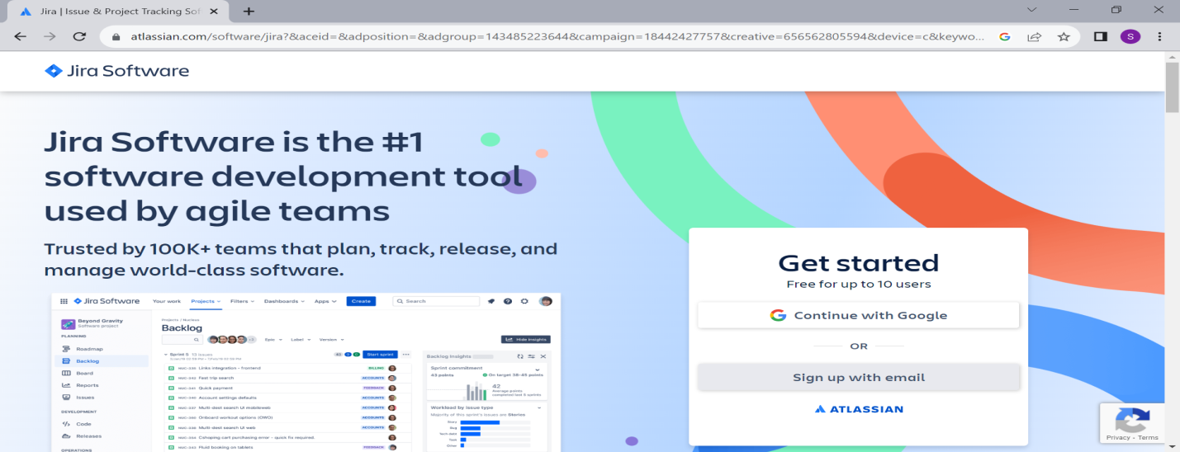

Slide 4
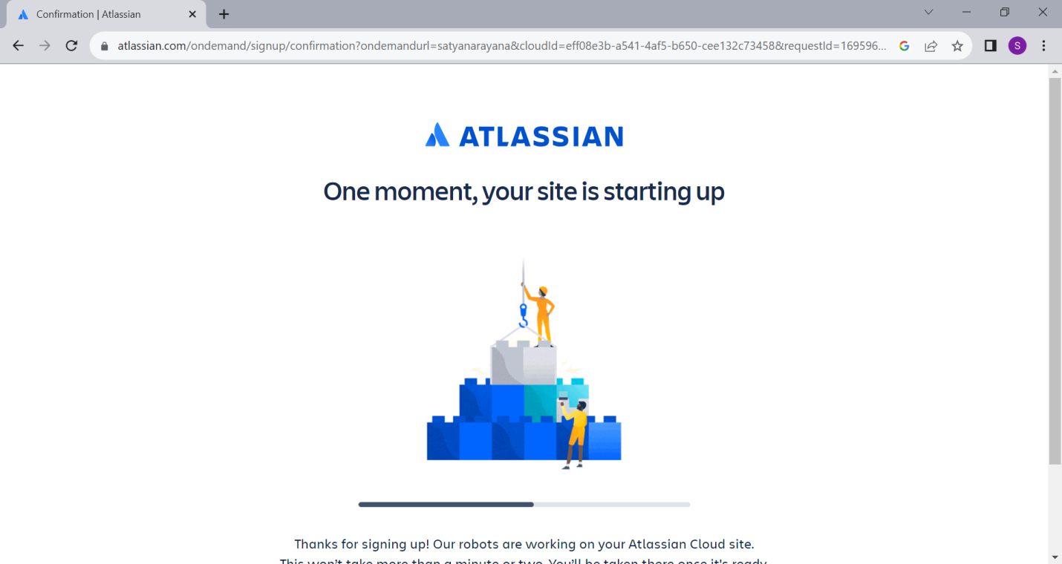

Slide 5
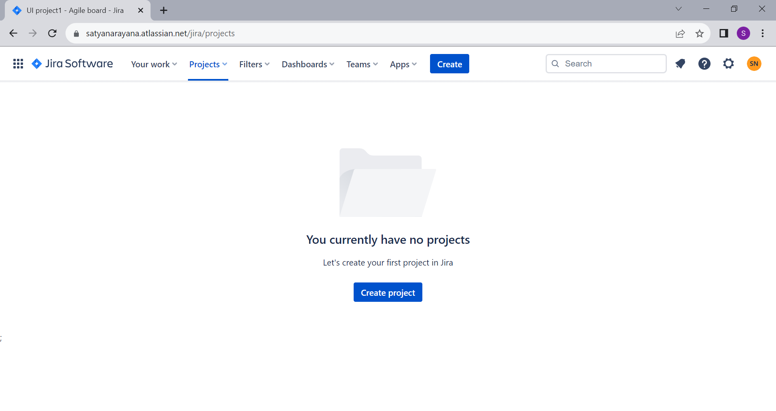

Slide 6
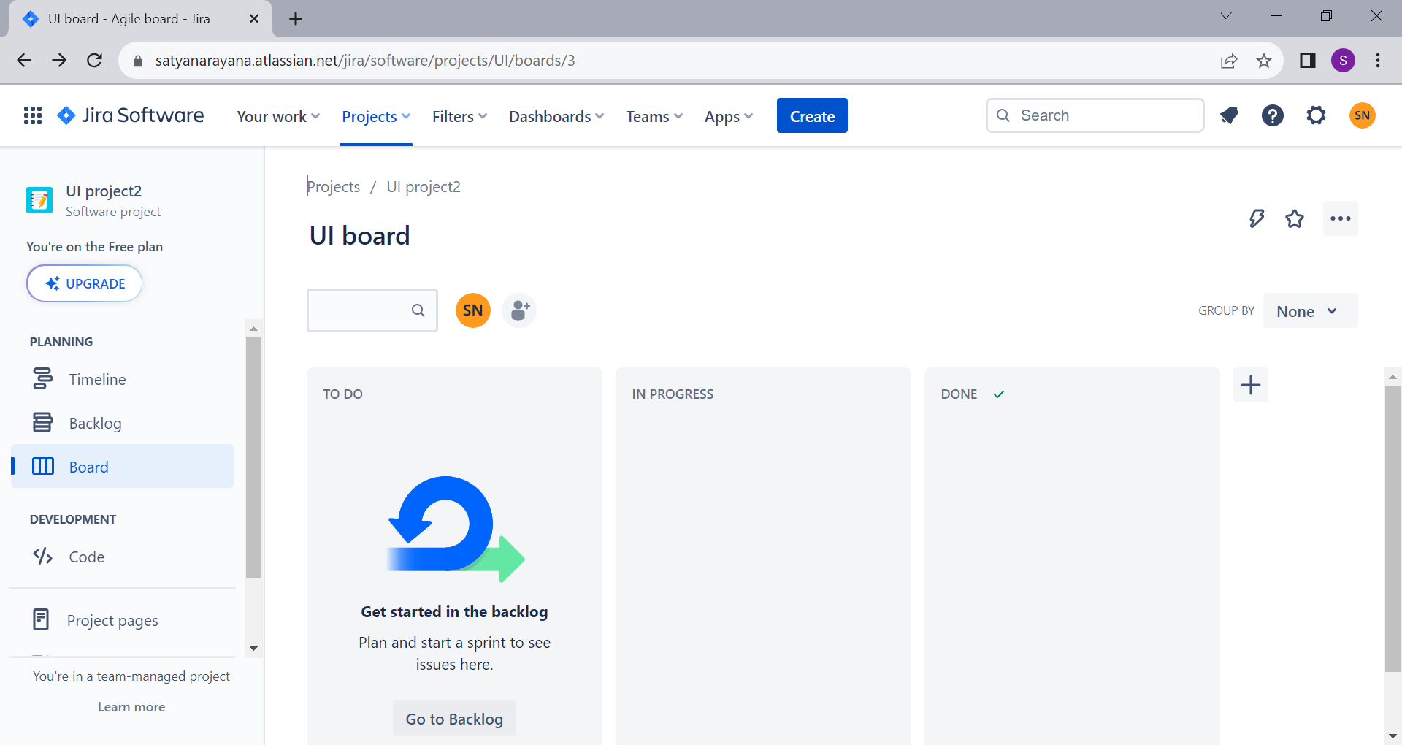

Slide 7
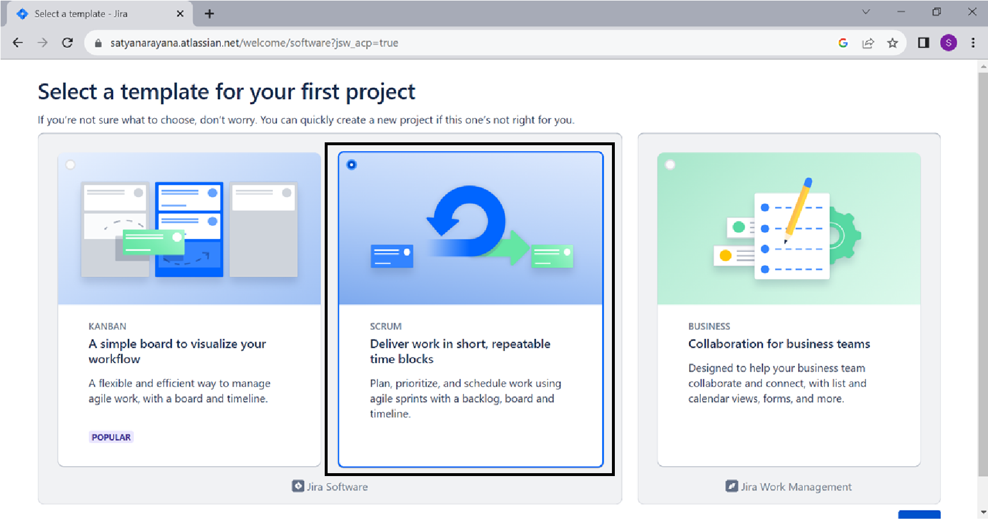

Slide 8
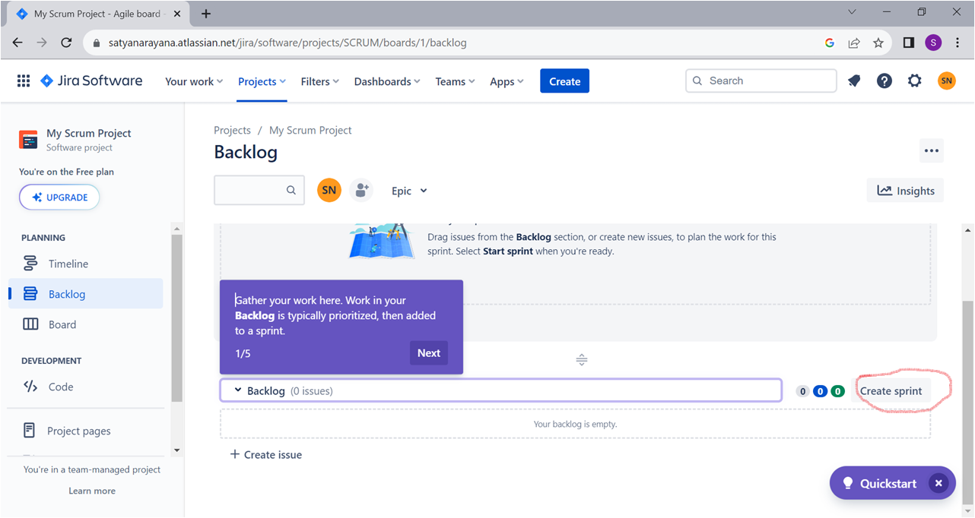

Slide 9
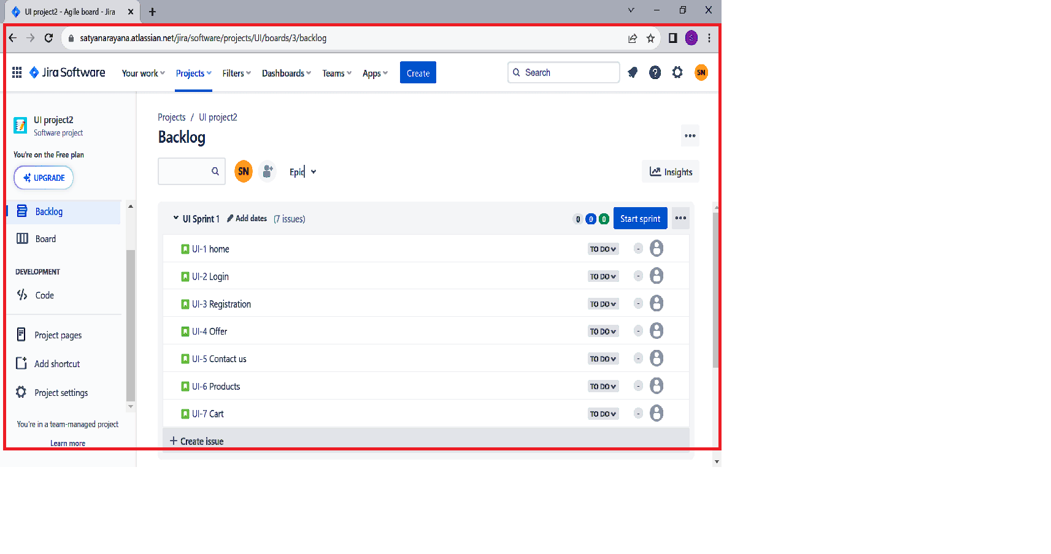

Slide 10
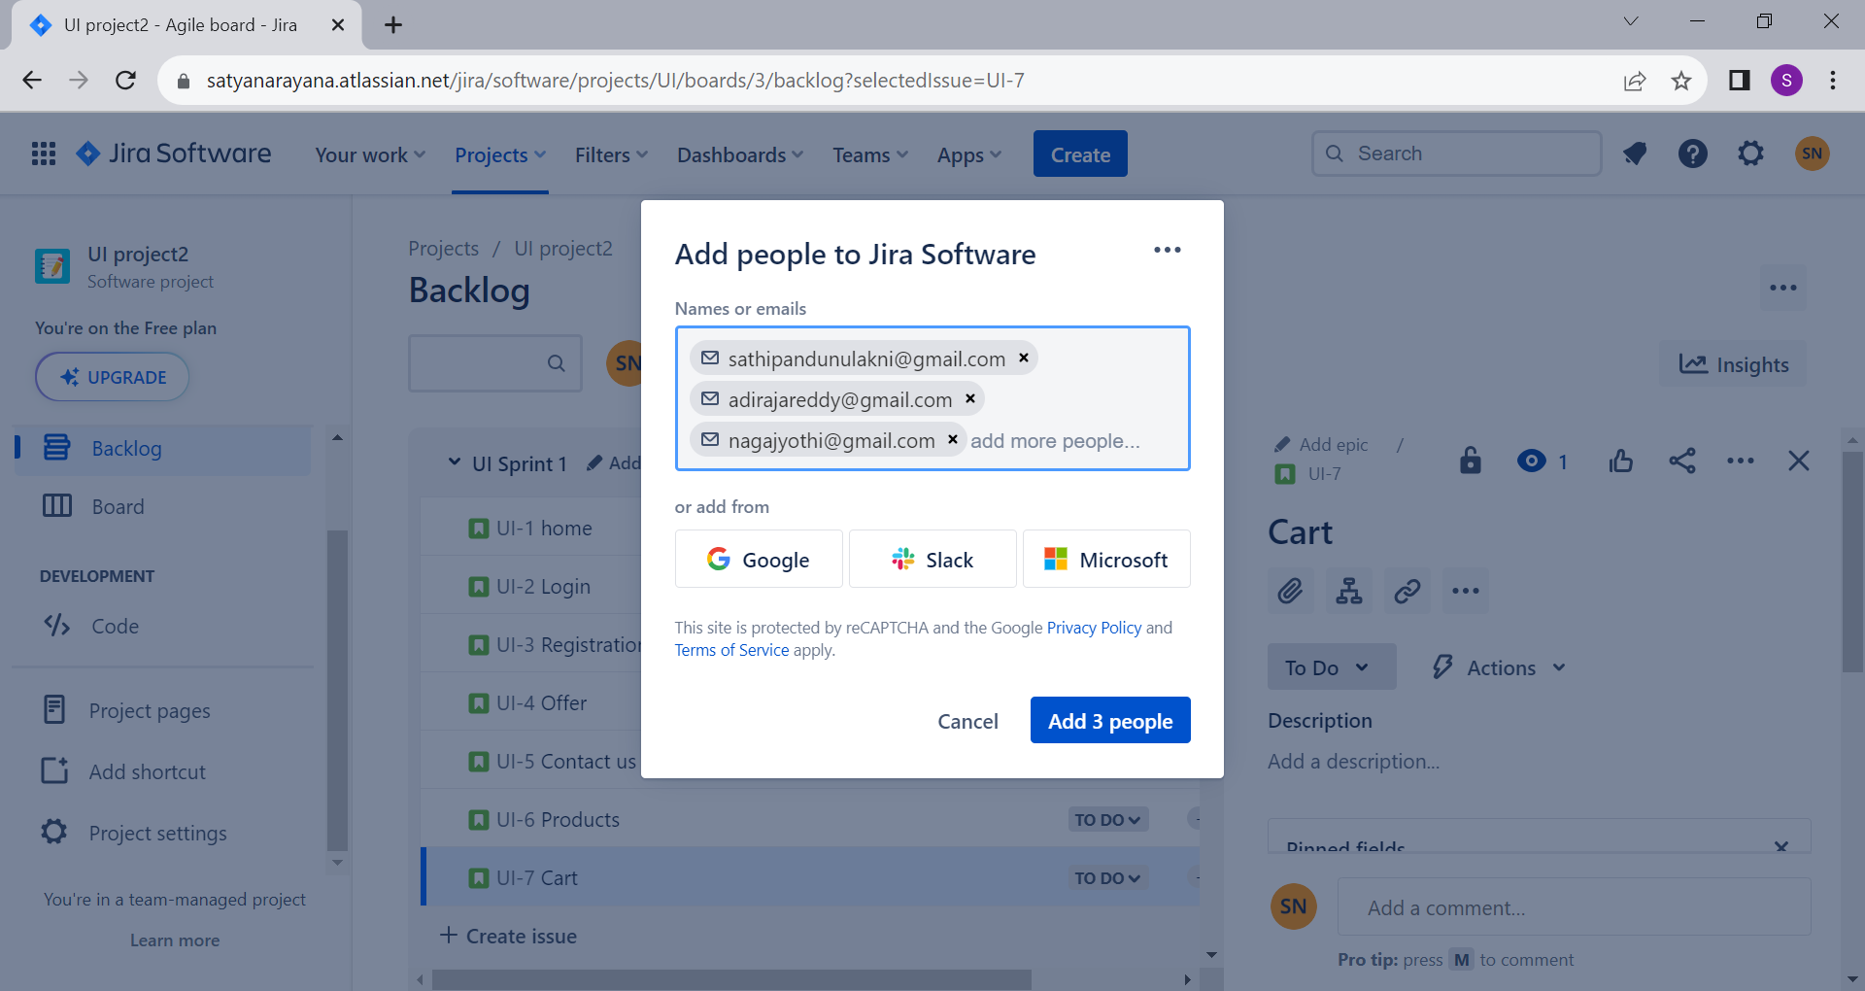

Slide 11
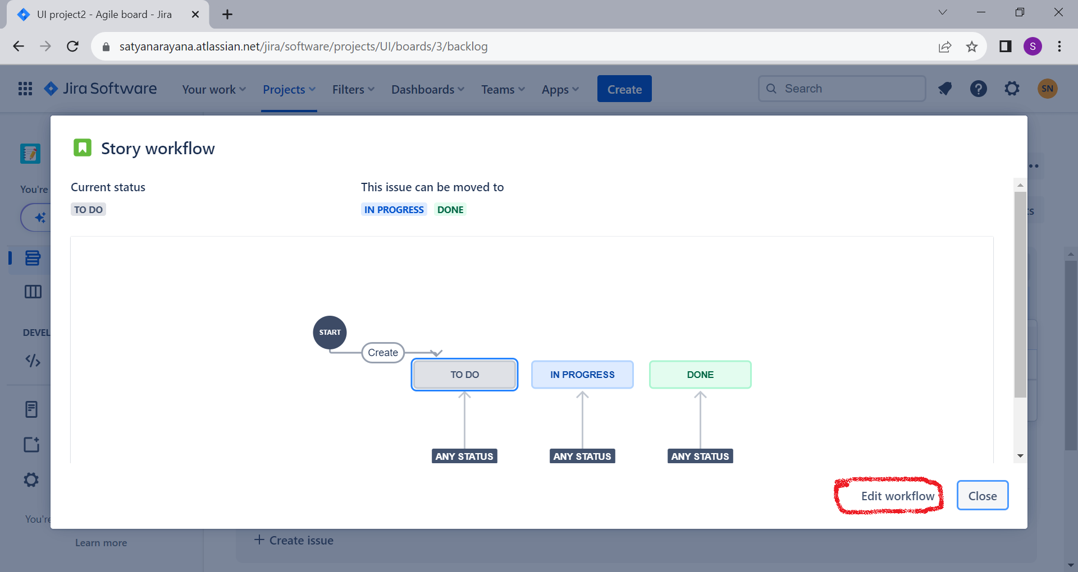

Slide 12
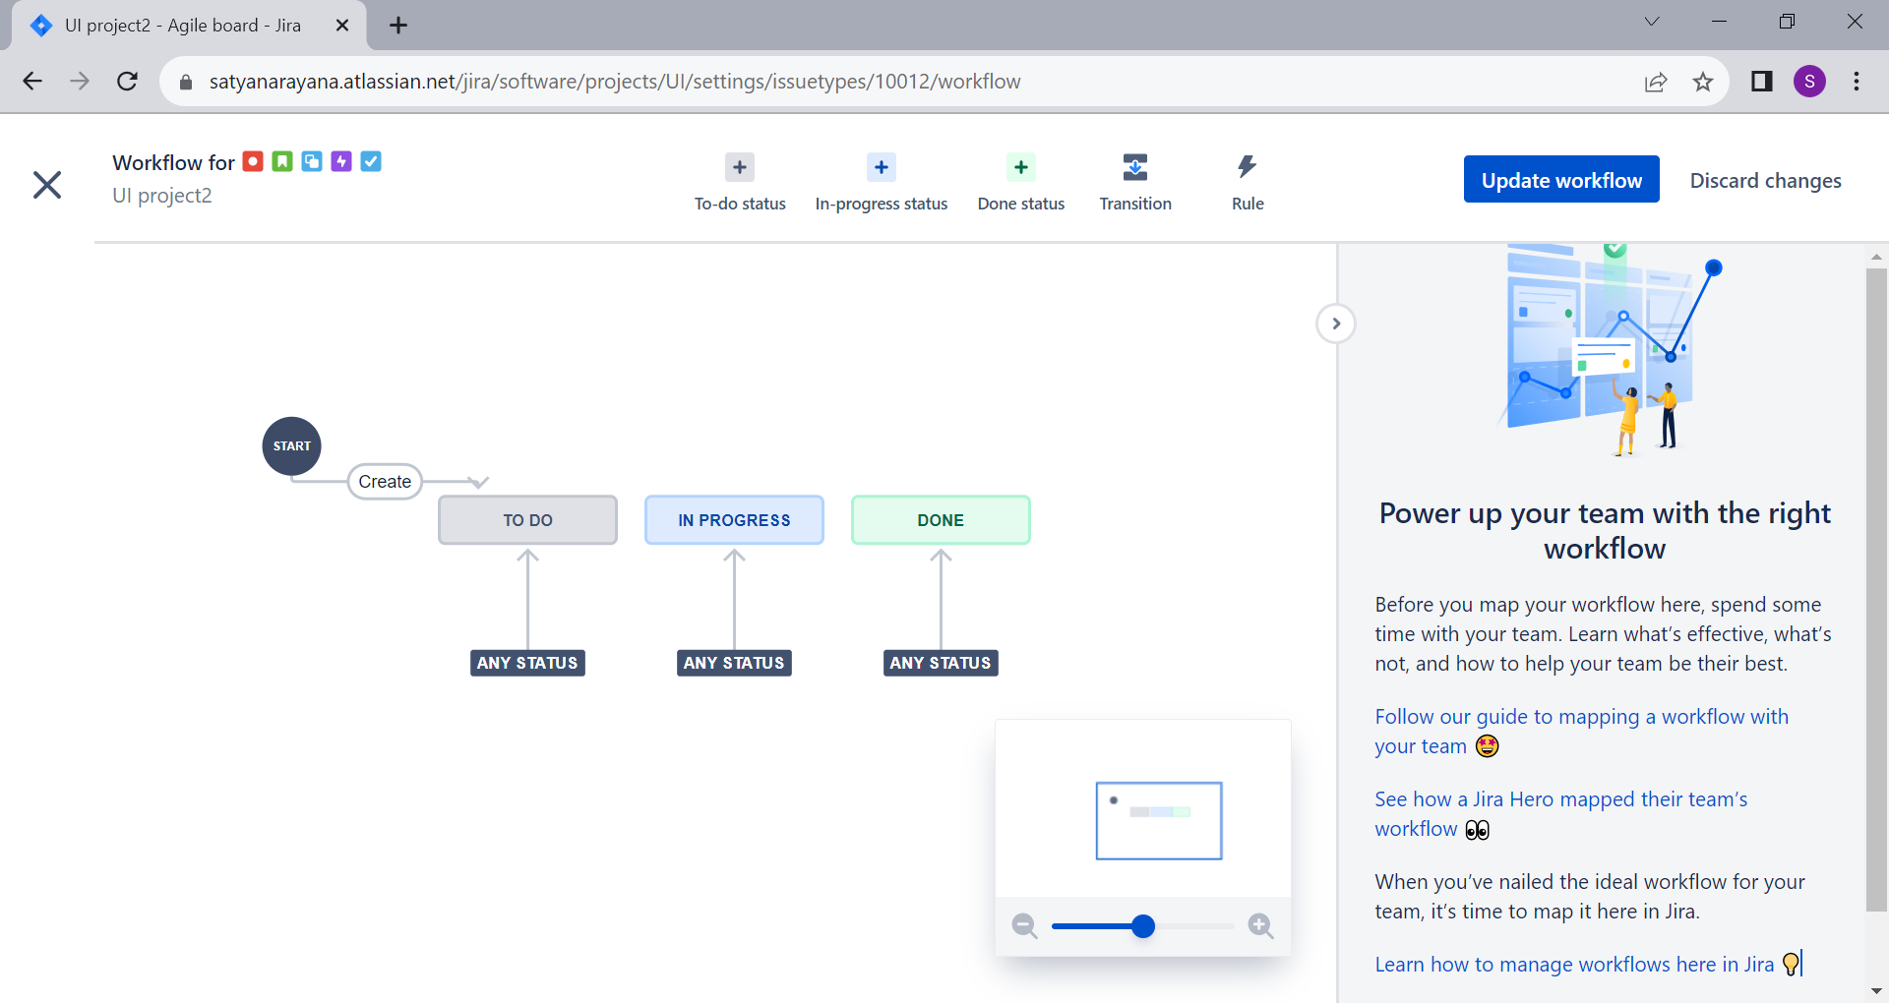

Slide 13
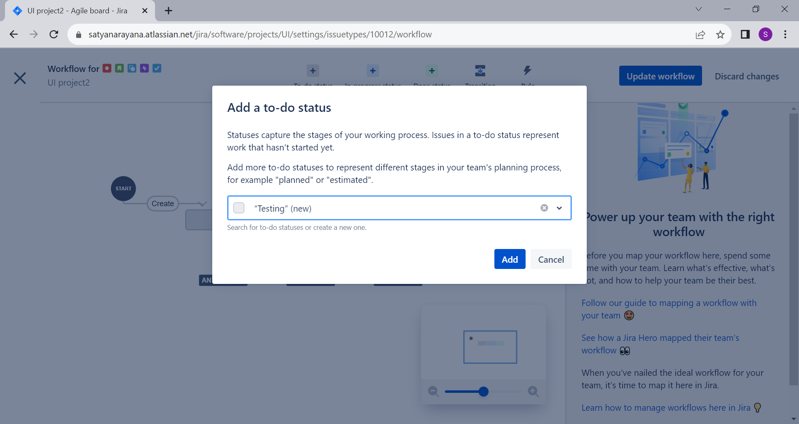

Slide 14
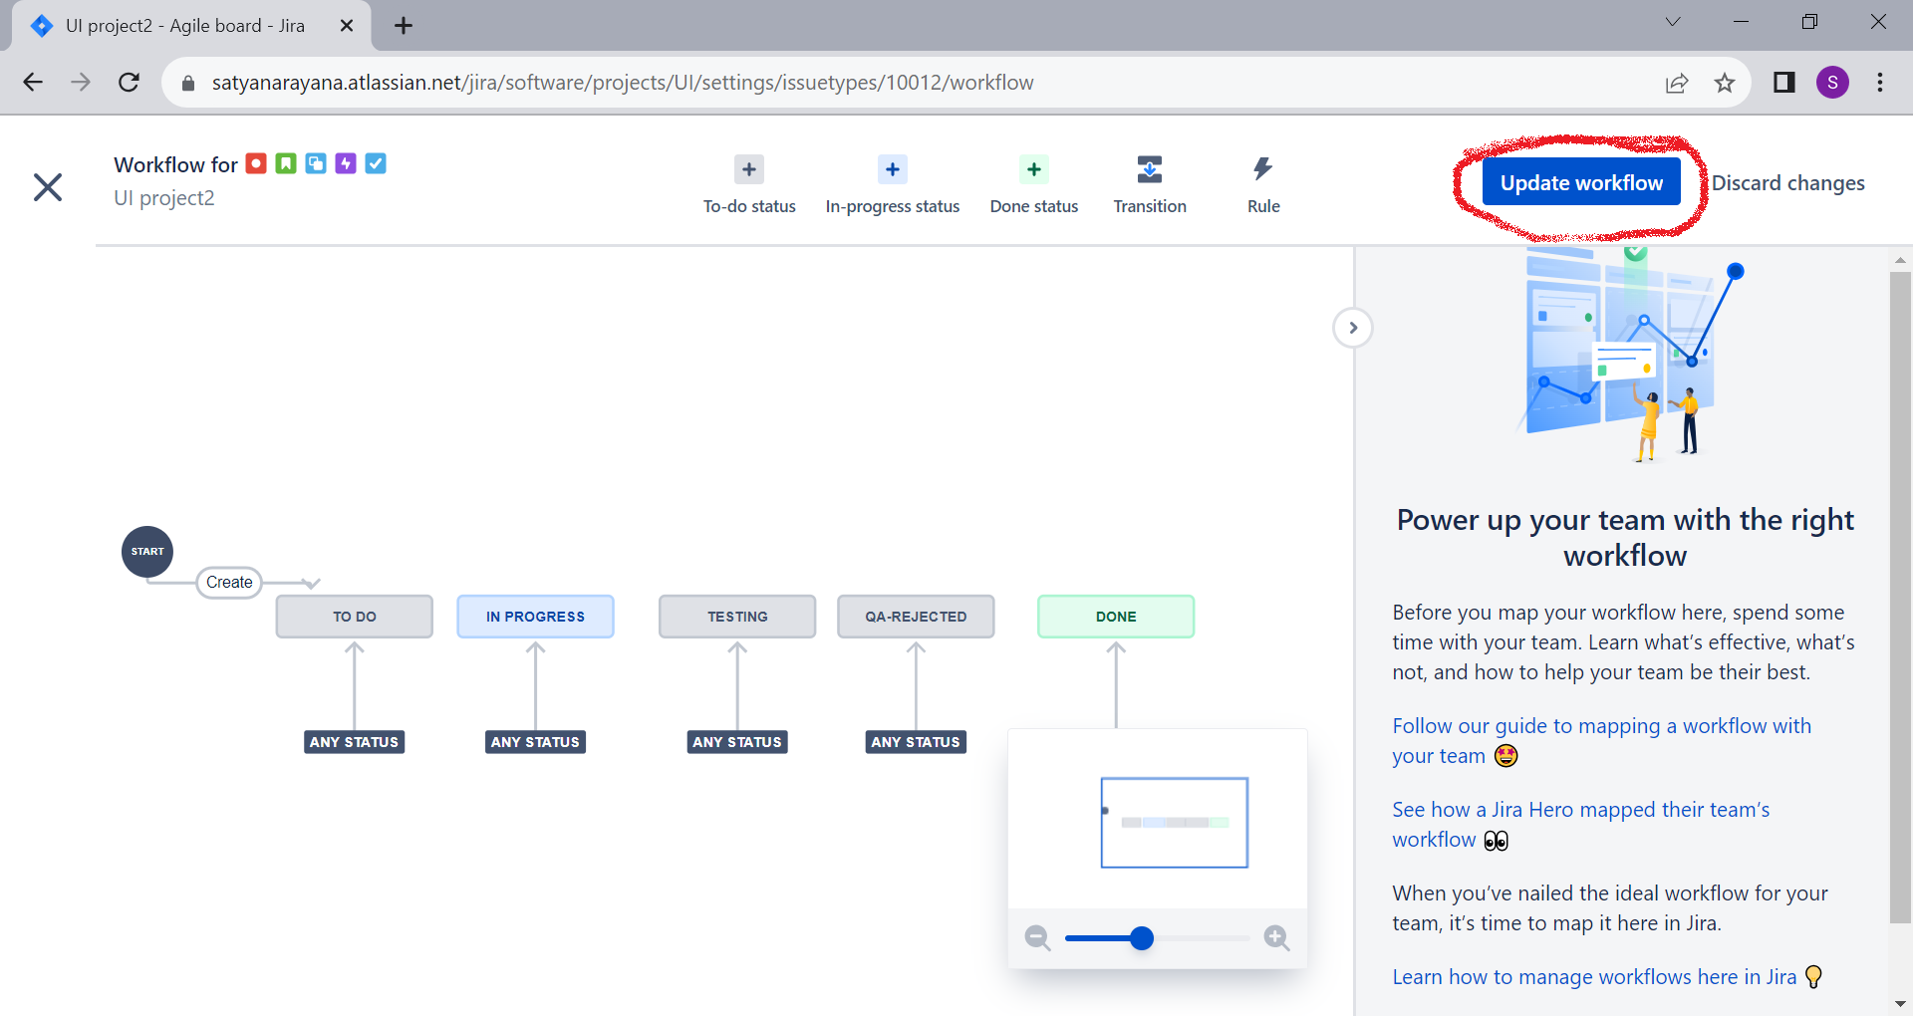

Slide 15
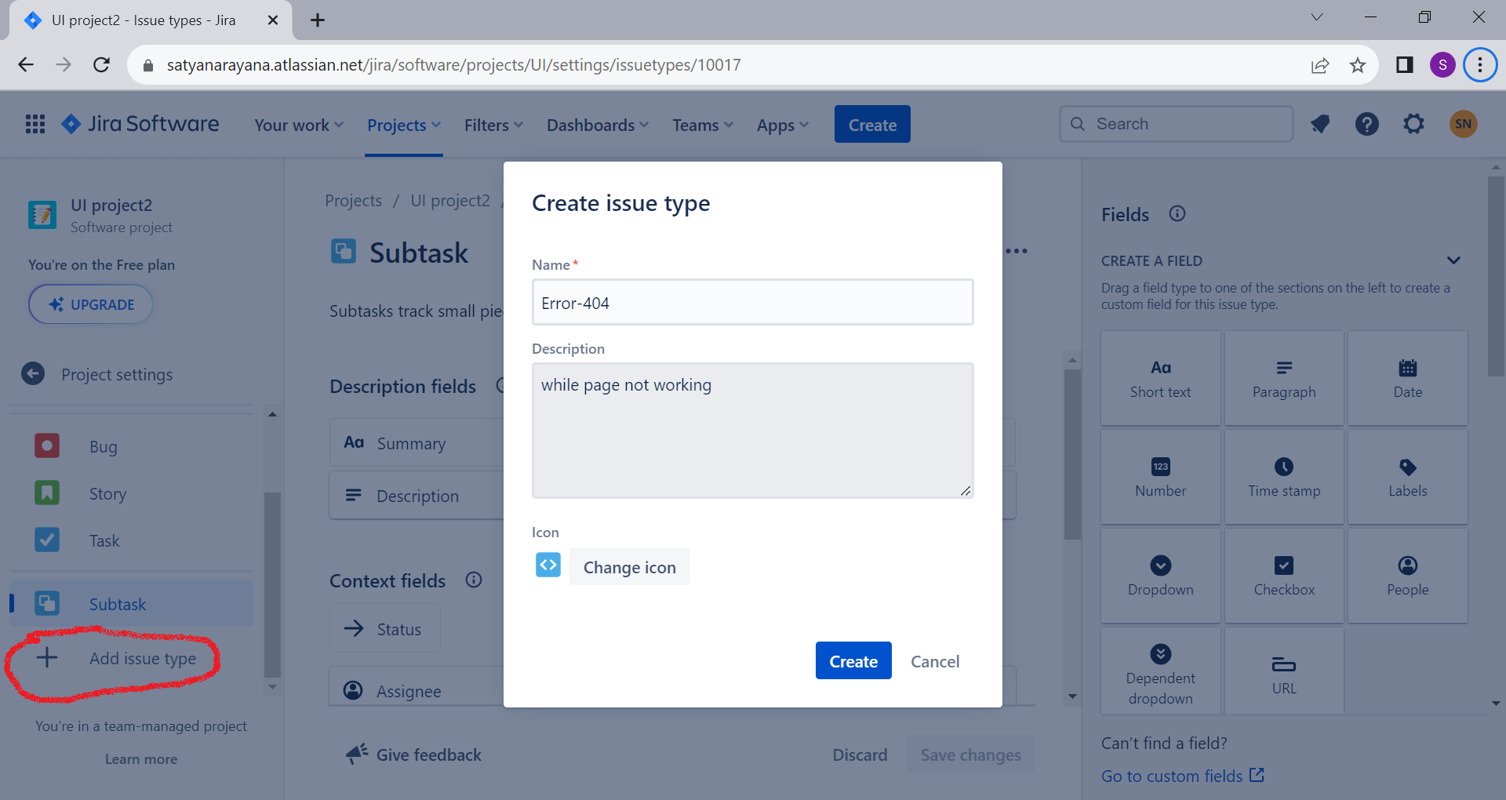

Slide 16
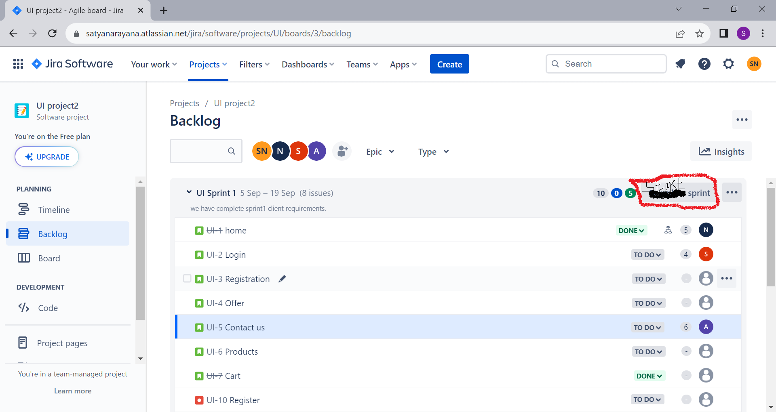

Slide 17
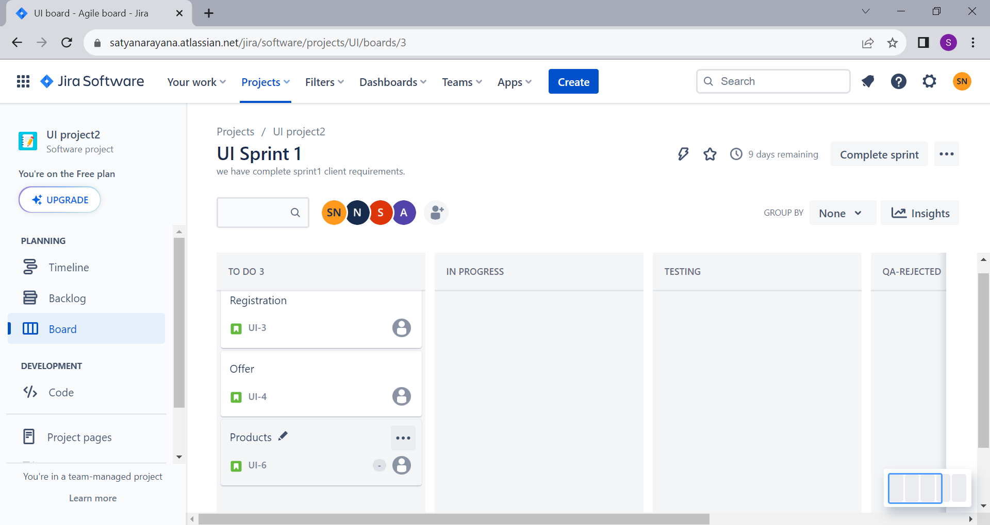

Slide 18
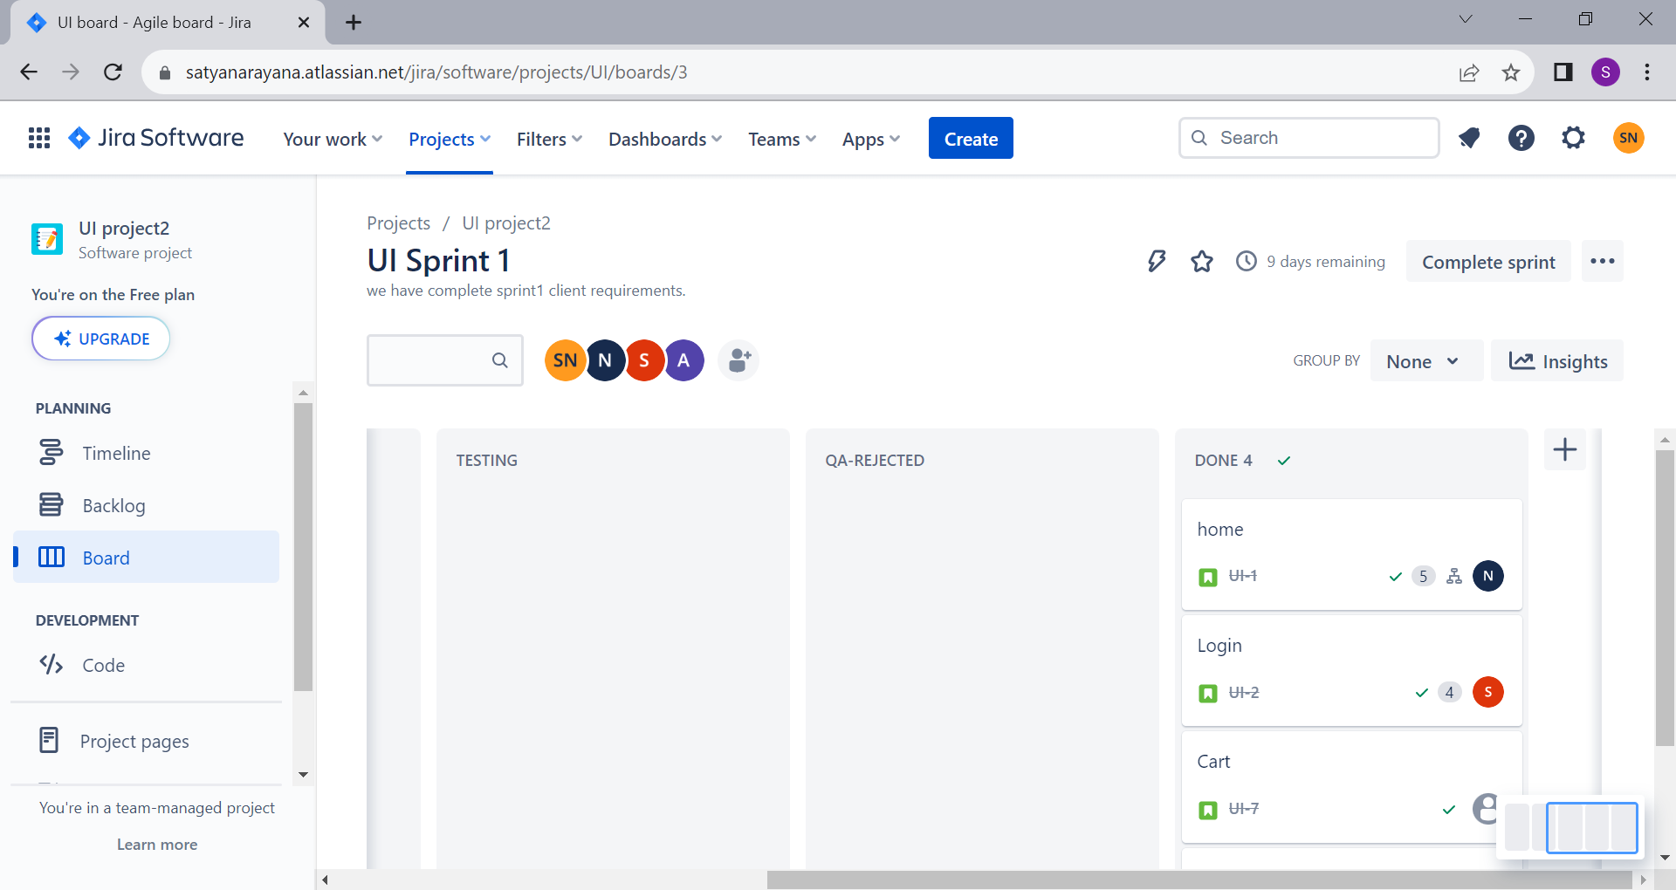

Slide 19
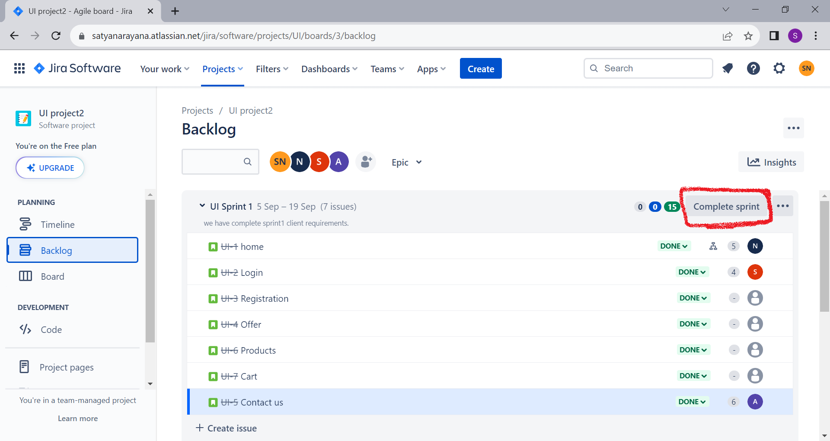

Slide 20
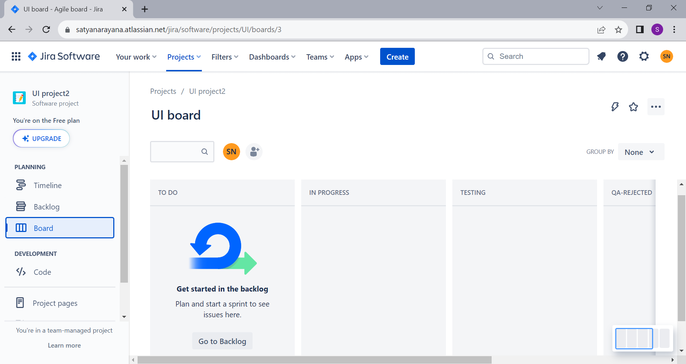

Slide 21
